Slide 1
Fire Detection Aerospec Project
Satwik Vivek Naik
Sai Phani Kumar Reddy Sulguti
Tridev Sudhakar
Sree Pavan Goli

Slide 2
Objective
To design a mechanism for fire detection in an industrial environment.
Objective achieved through machine learning algorithm implemented on Raspberry Pi 3 with the use of Logitech C920e camera.

Slide 3
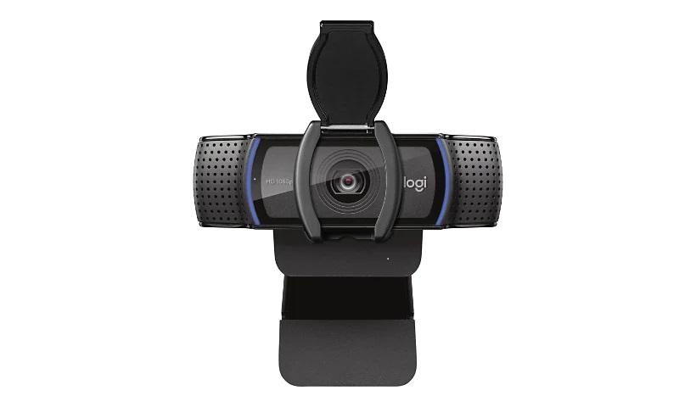
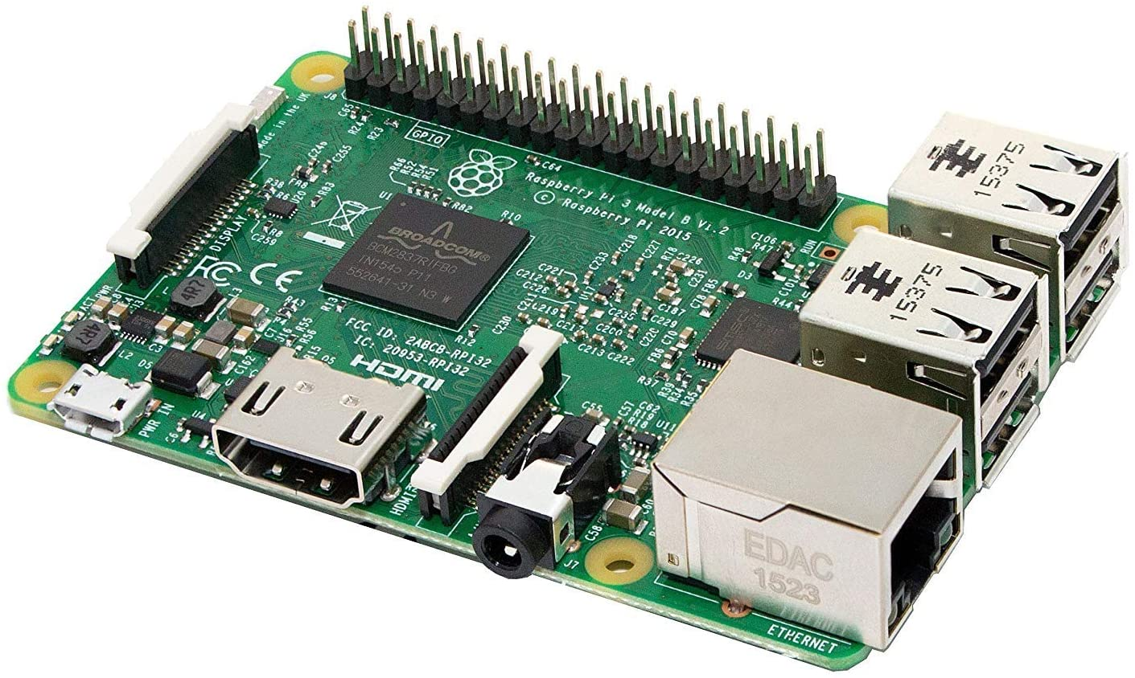
Components used
Raspberry Pi 3:
Specifications
Quad Core 1.2GHz Broadcom BCM2837 64bit CPU.
1GB RAM.
BCM43438 wireless LAN and Bluetooth Low Energy (BLE) on board.
100 Base Ethernet.
40-pin extended GPIO.
4 USB 2 ports.
4 Pole stereo output and composite video port.
Logitech C920e Camera:
Specifications
Image resolution: up to 15 Megapixels.
Video Resolution: 1080p at 30 fps / 720p at 30 fps.
Still Image Resolution: 1920x1080.
Diagonal Field of View (FOV): 78°

Slide 4
Methodology
Obtaining data sets and implement Aerospec videos into training set
Finding an optimal ML model for the fire detection and market survey
Using OpenCV for image processing of color detection and filter out glare
Training and testing the Machine learning model for best accuracies using tensor flow and keras (Pretraining)
Integrating the model into the Raspberry Pi 3 hardware using tensorflow lite and deploy pretrained model
Testing with camera and tuning parameters to achieve optimality
Testing the model through hardware.

Slide 5
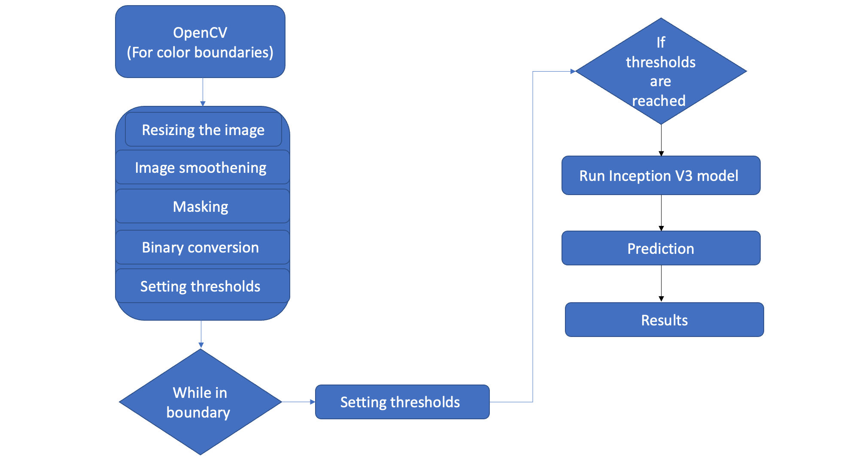
Methodology

Slide 6
Software tools used
Coding interfaces / Libraries / Tools | Version | Applications
Python | 3.7.9 | To implement the ML model
Tiny python Raspberry pi | Python 3 | To implement the ML model into model.
Keras | 2.7.0 | For image processing
Tensorflow/ Tensorflow lite | 2.7.0 | For image processing

Slide 7
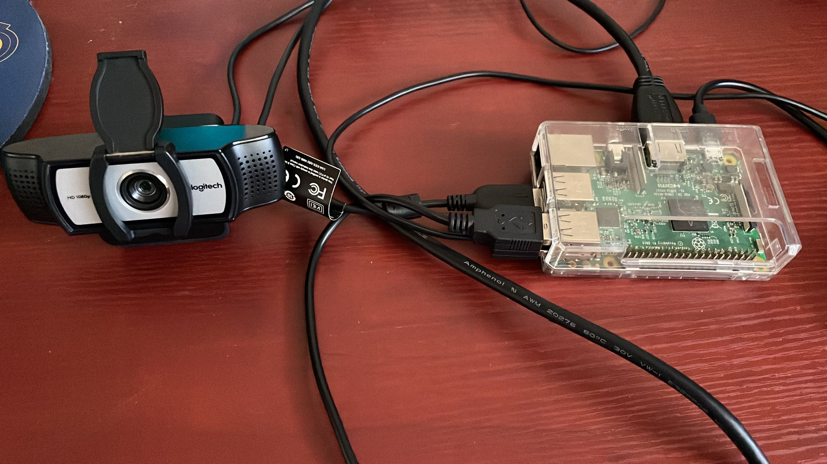
Model Setup
Raspberry pi 3 is connected to the Logitech camera through a usb port on the Raspberry pi.
The setup is shown below.

Slide 8

Results
Color separation and detection:
Color separation is achieved using opencv. The video is split into frames.
The frame obtained is then resized and mask is applied to filter out the image and detect only fire. Reflections are caught as false positives and can be tuned and filtered based on setup location.
The frame is converted into binary (black and white). The white pixels are counted to determine chance of fire. This process can be seen in the video below.

Slide 9
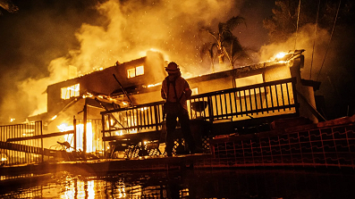
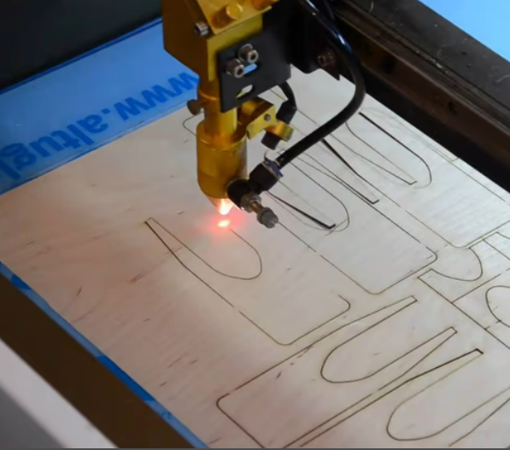
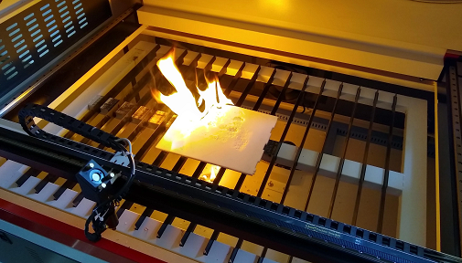
Results
ML Training and Testing:
A dataset containing fire and non-fire images is taken and trained using Inception V3 model in .tflite format.
Once trained the program is run on the test set and real time video feed.
The fire was detected with an accuracy of 90% when run on the test set and real time feed. False positive values had a low prediction values at around 55% and can be eliminated using threshold marking.

Slide 10
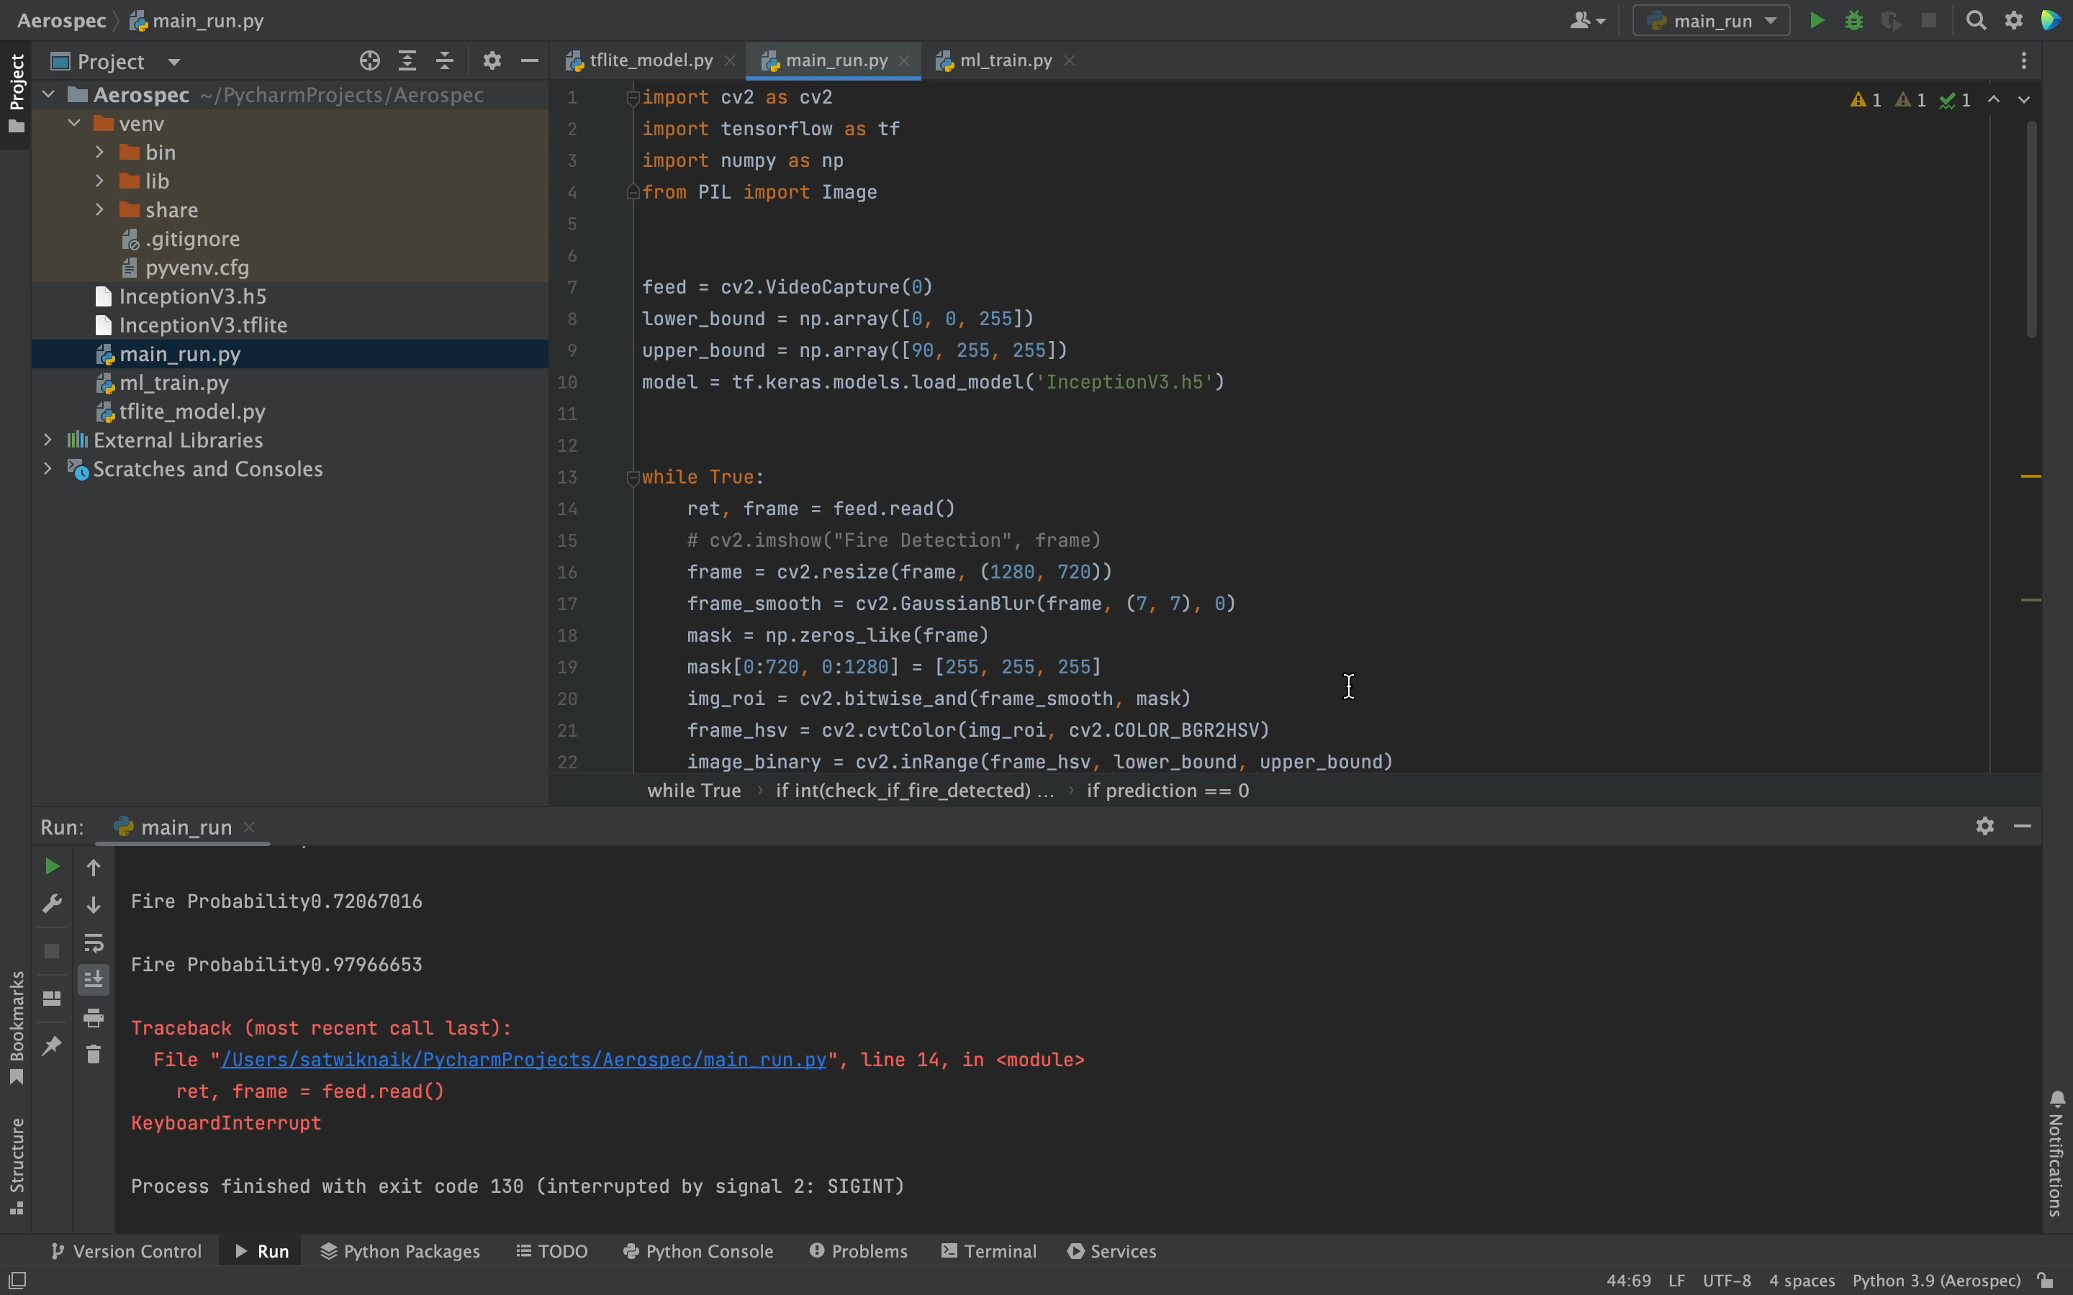
Results
Fire is detected accurately as shown in the video. This model is run on a regular laptop and image processing is quick due to the processing power of the CPU. The average accuracy for this case is around 93%. (Please notice the terminal window in video)

Slide 11
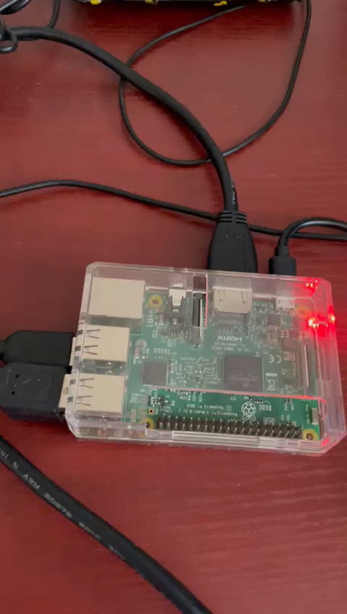
Results
Raspberry pi implementation:
The program is uploaded onto Raspberry pi and code modified to cater to raspberry pi functions.
The whole setup is connected to a monitor to see the results on the serial monitor of Raspberry pi.
The testing of the setup is showcased in the video below. The image processing seems a little slow and this is because of the raspberry pi’s processing power. With a 4GB ram this issue can be resolved.

Slide 12
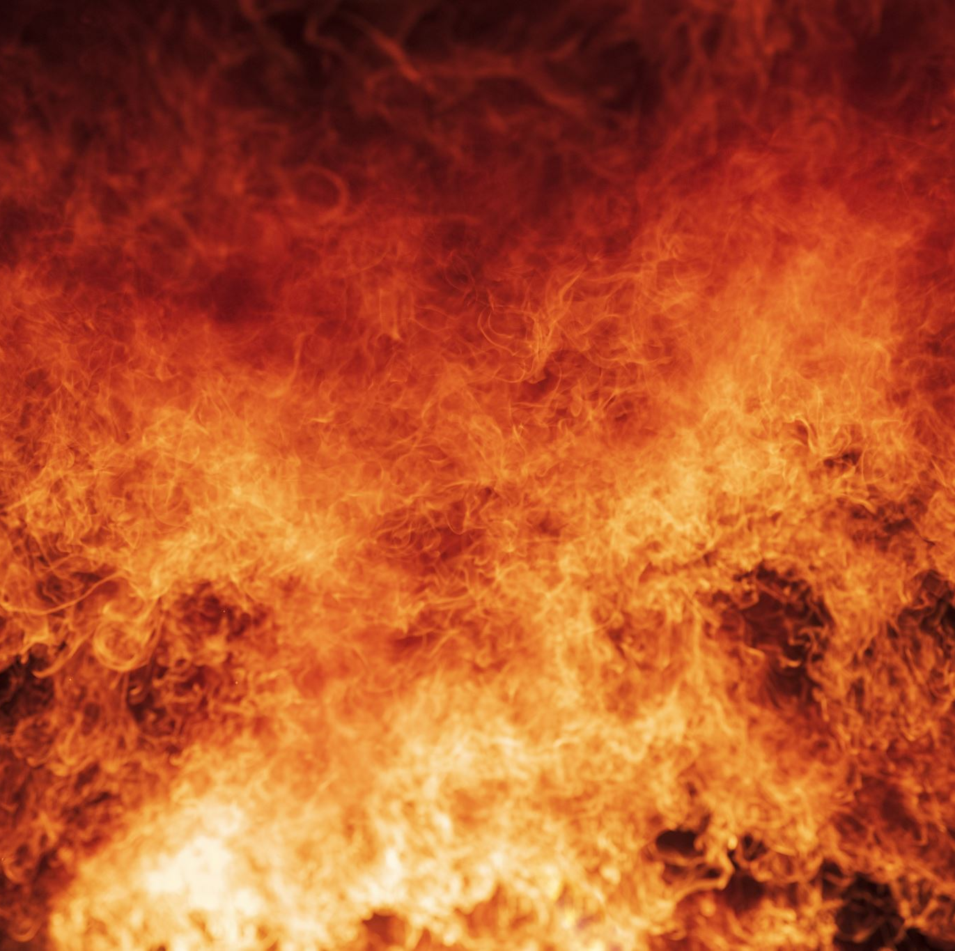
Conclusion
The video is accurately analyzed by the program and conversion is performed on it.
The ML predicts fire with an accuracy of 90% when a flame is detected.
Successful implementation of program into Raspberry pi is implemented

Slide 13
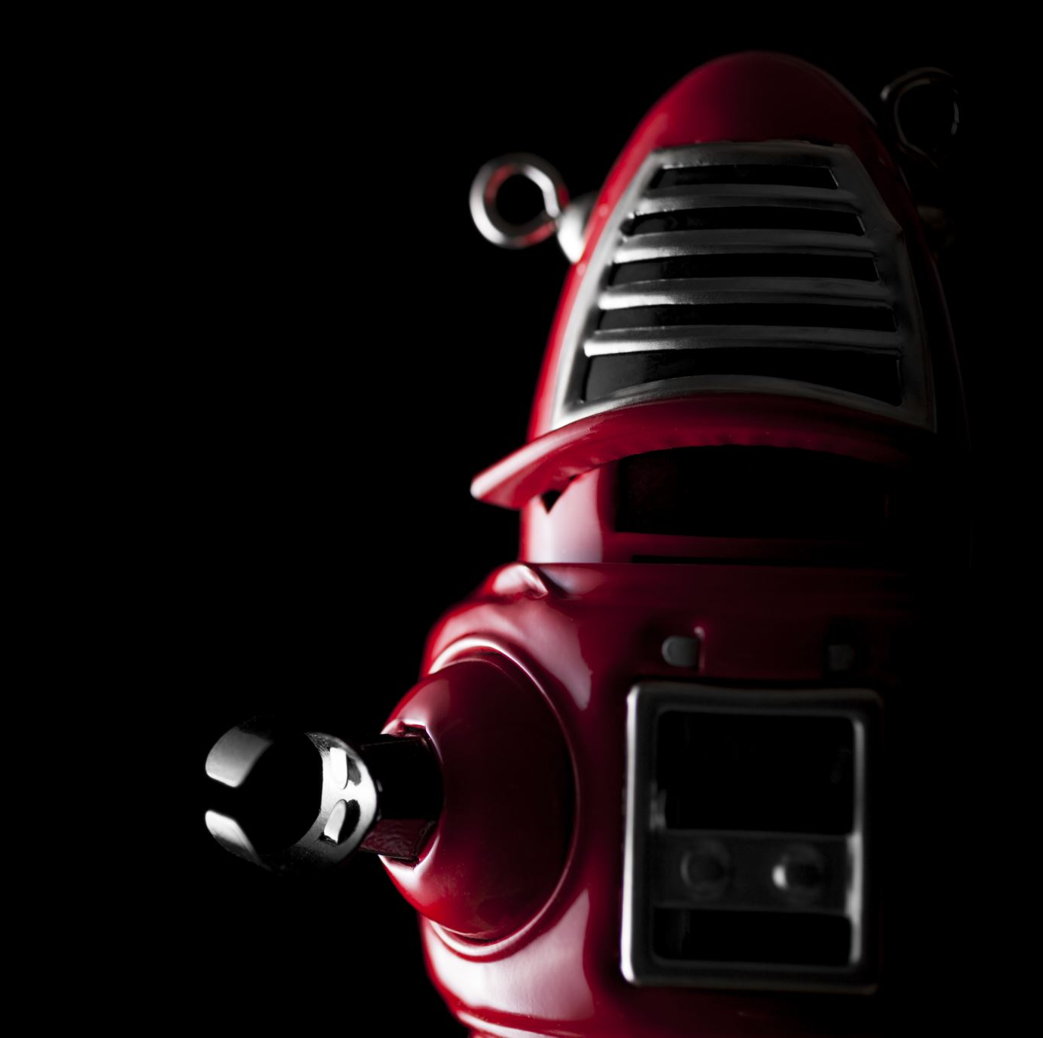
Future Work
Thermal camera has always more optimality in increasing the accuracy of the prediction model. Hence , we are looking to implementing it.
Once the proposed model is finalized, monitoring facility can be added like giving a voice feedback (speaker)or visual feedback(LED’s).
Ensemble learning can be implemented to improve accuracy. This will however require something more powerful than the raspberry pi.

Slide 14
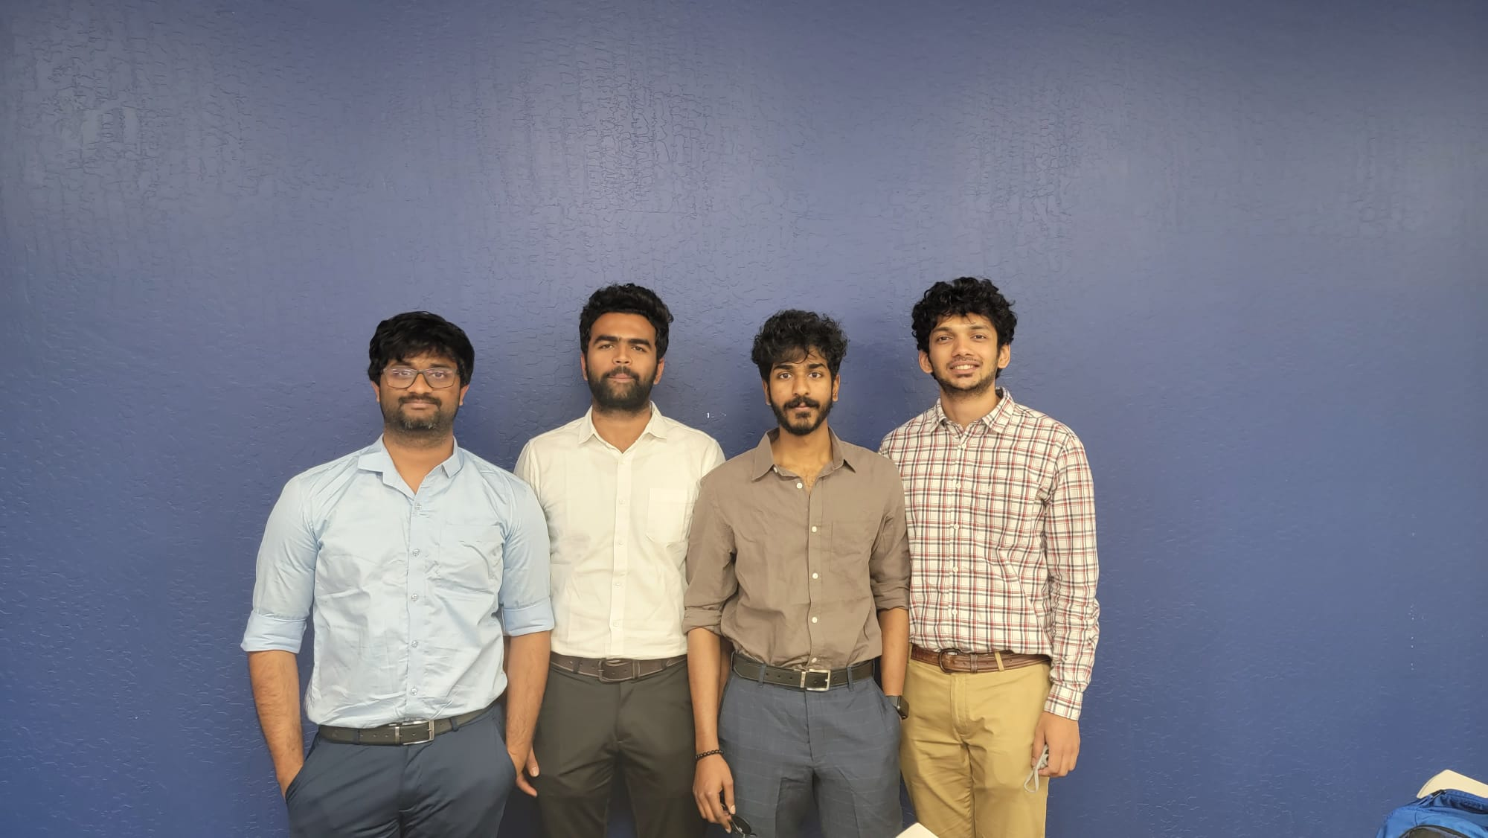
Thank you and Question?

